Slide 1

Mastering the Means Test
2012
Cathy Moran
Susanne Robicsek

Slide 2

$195.42

Slide 3
MeansTestCompendium
@gmail.com

Slide 4
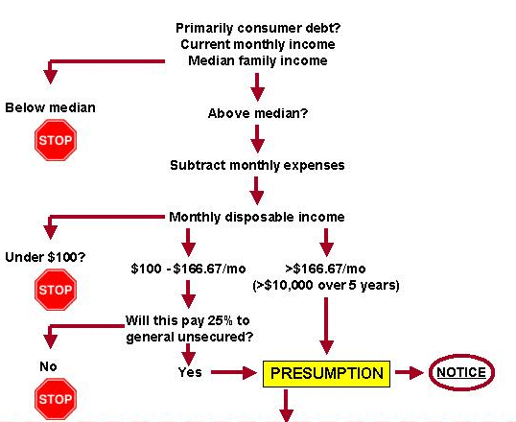
ABUSE?
$117
$117
$!95
$195
$11,7255555
Notes:
How did we get to this tangle?
Myth of can pay debtor
attack on judicial discretion
BEFORE: income AND expenses projected
NOW: income is backward looking, expenses forward looking
Overview of 707(b)- enter the maze with me
exercise yield PRESUMPTION OF ABUSE
ENTITLEMENT OF UNSECUREDS
INCOME issues BREAK DEDUCTIONS

Slide 5

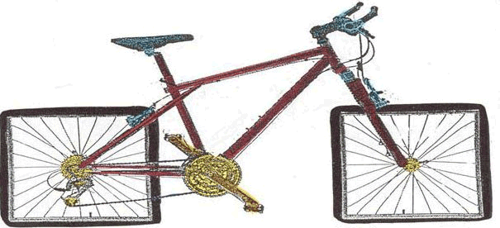
Who thought this works?

Slide 6

Income Expenses
Notes:
Includes mortgages
Kelly 841 F.2d 908 (9th Cir. 1988)
Stine 254 B.R. 244 (9th Cir. BAP 2000)

Slide 7
Who is subject to means test?
  Every individual debtor
  whose debts are primarily consumer debts
EXCEPT
  Disabled veterans
  Active duty reservists or National Guard
Notes:
Effect is that one of the most critical calculations isn’t on the form

Slide 8
What’s a consumer debt
debt incurred
  by an individual
  primarily for a personal, family, or household purpose.
§101(8)
Notes:
Includes mortgages
Kelly 841 F.2d 908 (9th Cir. 1988)
Stine 254 B.R. 244 (9th Cir. BAP 2000)

Slide 9
Not consumer debt
-Taxes
  Income Payroll Property
-Debts incurred for business or profit
  Investment debt
  Mortgages on rentals
  Credit cards & home equity lines used for business
  -Tort Claims

Slide 10
Categories of Income
3. Wages
4. Income from business
5. Rental income
6. Interest, dividends & royalties
7. Pensions
8. Amounts paid by others for household expenses
9. Unemployment compensation
10. Income from all other sources

Slide 11
Line 8: Amounts paid by others
Statute says:
  CMI includes any amount paid by any entity other than the debtor on a regular basis for the household expenses of the debtor or the debtor’s dependents

Slide 12
Current Monthly Income
  the average monthly income from all sources
  that the debtor receives (or in a joint case the debtor and the debtor's spouse receive)
  without regard to whether such income is taxable income,
  derived during the 6-month period
  §101(10A)

Slide 13
Included Income
Wages
Gross business revenue
Rent
Family support received
Pension or retirement income
Disability income

Slide 14
Exclusions From Income
  Social security payments
  Unemployment insurance payments – Sorrell
  Payments on account of war crimes or terrorism

Slide 15
Is it income?
  IRA withdrawals
  Asset sales
  Tax refunds
  Gifts
  Business expense reimbursements

Slide 16
Received & Derived?
  CMI “ means the average monthly income from all sources that the debtor receives (or in a joint case the debtor and the debtor's spouse receive) without regard to whether such income is taxable income, derived during the 6-month period ending on--”
  §101(10A)

Slide 17

Get the documents

Slide 18
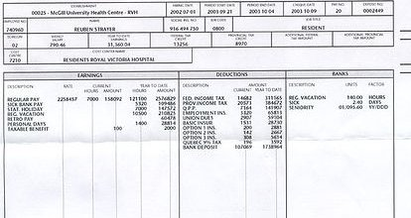
Create a key

Slide 19
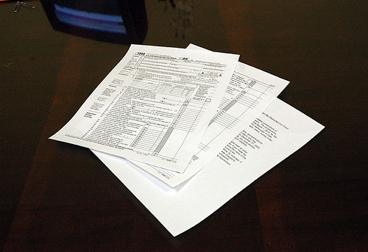
Check the tax return

Slide 20
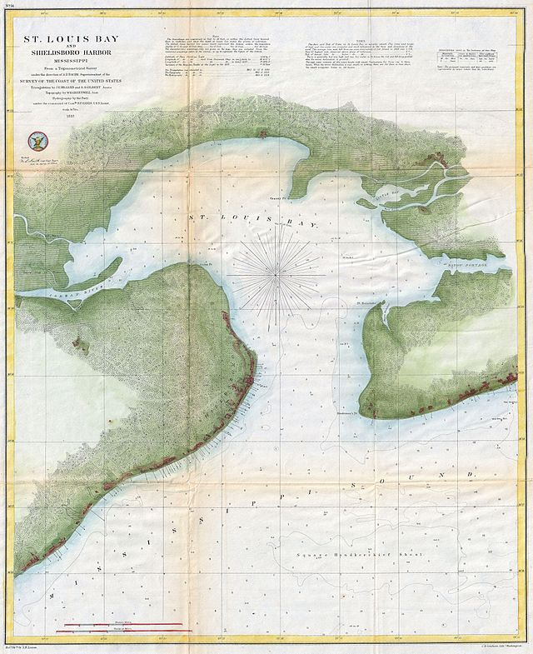
Safe Harbor
No one may challenge debtor’s right to file Chapter 7 under
§ 707(b)(2)
If CMI is equal to or less than median
§707(b)(7)

Slide 21
Line 14 Median Family Income
Household size determines the median income point-
and whether the safe harbor of §707(b)(7) applies
Notes:
Neither family nor household is defined; the cen

Slide 22
Household or Family
Abuse presumed if
annualized current monthly income of the debtor and the debtor’s spouse is equal to or less than the median family income of the applicable State …for a household of X individuals
§707(b)(2)
Notes:
Neither family nor household is defined; the cen

Slide 23
Why household size matters
Expense allowances keyed to household size
  Going from household of 1 to household of 2 increases deductions by $861
  Going from household of 3 to household of 4 increases deductions by $538

Slide 24
“Household” as heads on beds
A household includes all the persons who occupy a housing unit....The occupants may be a single family, one person living alone, two or more families living together, or any other group of related or unrelated persons who share living arrangements.
http://tinyurl.com/yz6u8j6

Slide 25
“Household” as tax dependents
  Uses the IRS definition of dependents as the definition of household
  Has no relationship to the number of people in the house
  Has logical connection to the treatment of the debtor's expenses in Part V of B-22

Slide 26



Slide 27
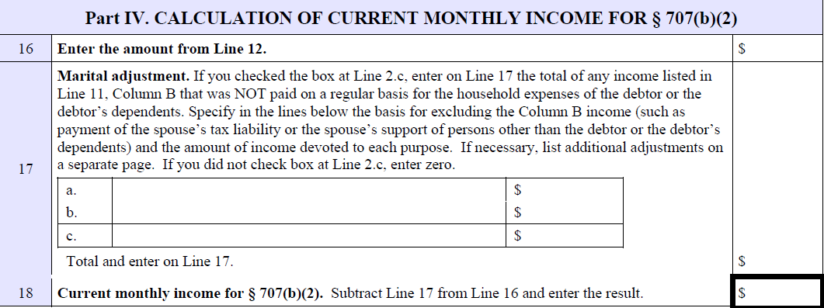
Lines 16-18 Marital Adjustment
Notes:
Applies only when only one spouse files
Applies only to

Slide 28
Exclude income of non filing spouse
Non filing spouse's income
not paid for household expenses of debtor & dependents
is excludable in calculating disposable monthly income
Notes:
Applies only when only one spouse files
Applies only to

Slide 29
Possible adjustments
support
separate debts
401(k) contributions
student loan payments
recreation & hobbies
bad habits

Slide 30


Stop or Continue
Equal to or below median……..
Above median ……………………..

Slide 31
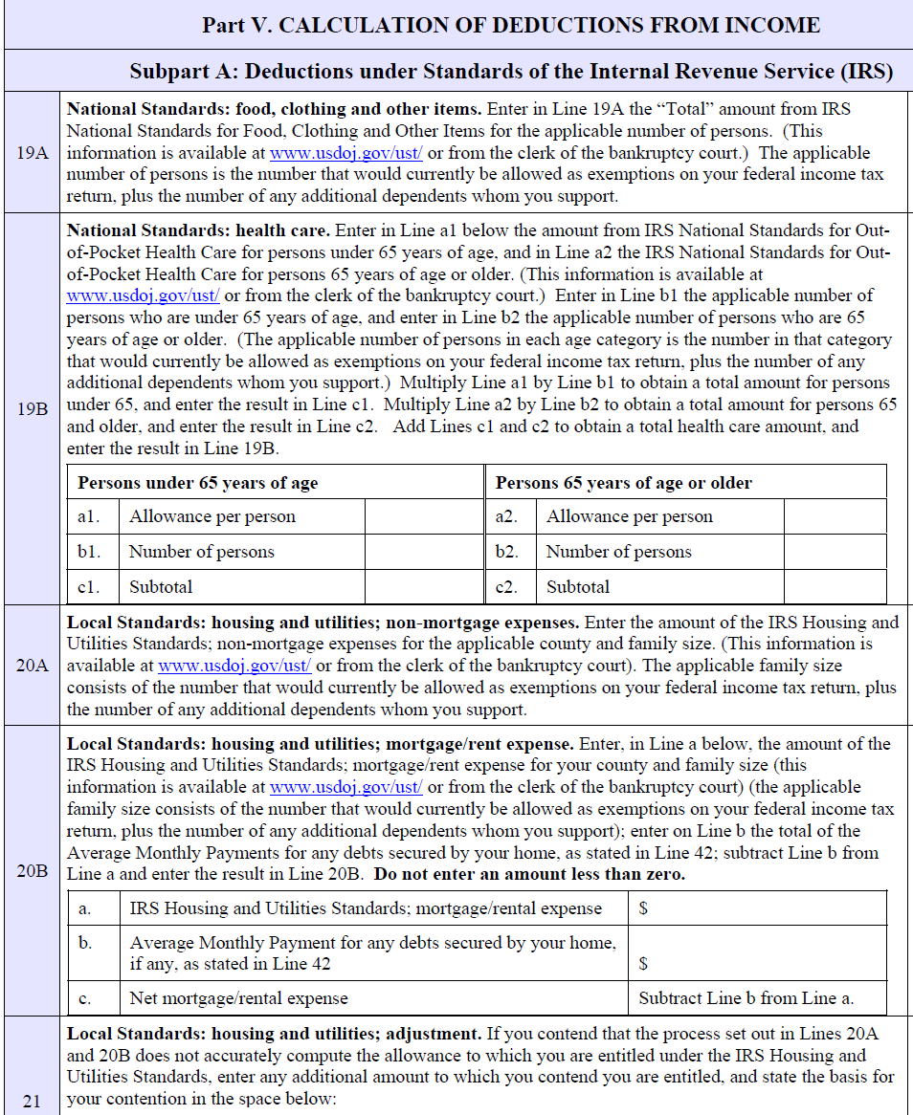
Deductions for the Above Median

Slide 32
Deductions from income
Subtraction in three parts
  IRS standards Lines 19-33
  Additional living expenses Lines 34-40
  Debt payment Lines 42-45

Slide 33
Standard deductions
Food & clothing
Health care
Non mortgage expenses
Housing: rent or mortgage payment
Transportation- public or vehicle operation
Vehicle ownership expense

Slide 34

Housing
Line 20B
  Deduct amount of IRS allowance if renting
OR
  Any amount the allowance exceeds monthly payment on debts secured by home

Slide 35
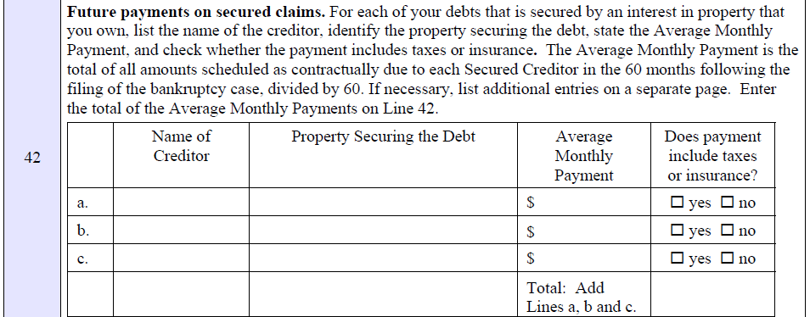
Debts secured by home

Slide 36
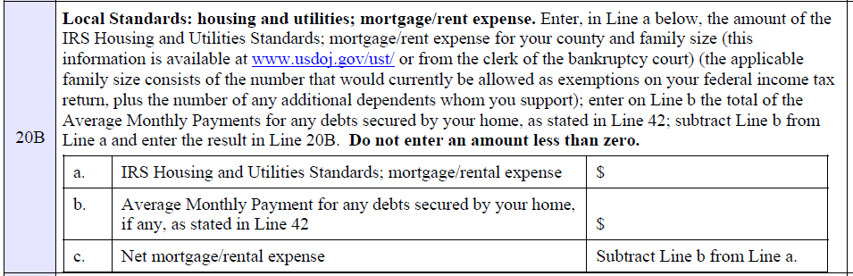
Mortgage/rent

Slide 37
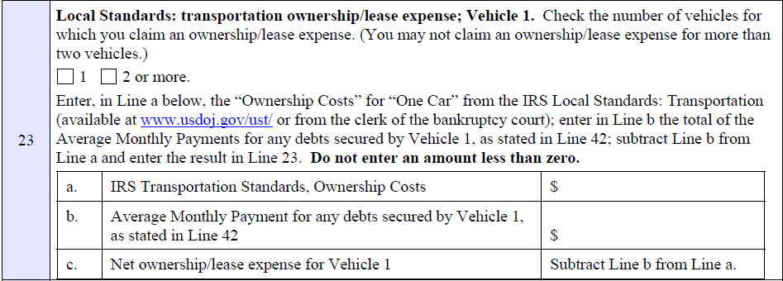
Car ownership allowance

Slide 38
Debts secured by car
Notes:
The amount is NOT the monthly payment; it is monthly payment

Slide 39

Deduction is not car payment
From the IRS standard ownership allowance, subtract
Monthly payments
X
# remaining payments
÷
60
Notes:
The amount is NOT the monthly payment; it is monthly payment

Slide 40
Jaberwocky
One car payment remaining
  Ownership allowance $489
  1/60 remaining debt < 5>
  Line 23 c $484
No car payment remaining
  Line 23 c 0
Ransom 131 S. Ct. 716

Slide 41

Old car operating allowance
Cars
more than 6 years old,
or
75,000 miles
entitled to increased operating expense of $200

Slide 42
Other Necessary Expenses
Lines 25-32 are kinds of expenses allowed under IRS collection standards
Allowed amounts are actual expenses, not IRS allowance figures

Slide 43
Taxes

Slide 44

Involuntary deductions
Notes:
Clues found on pay stubs- why you need a key
Union dues
Health, welfare, vacation funds
Uniforms
Mandatory retirement contributions
Line 26

Slide 45
Life insurance
Notes:
Only on debtor’s life, or life of non filing spouse? No deduction for insurance with investment component

Slide 46
Court ordered payments
Notes:
Remember these are future payments

Slide 47
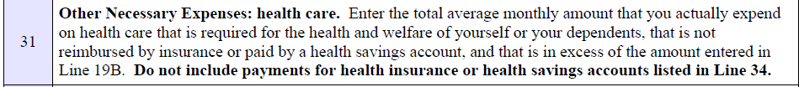
Health care

Slide 48
Project health care expense
  Determine undermet needs of family
  Medical procedures or care
  Postponed dental work
  Eye care
  Prescription medication
  Physical or mental therapy

Slide 49
Line 31 calculation
Total health care expenditures
less
Line 19B allowance
less
Health savings accounts

Slide 50
Bankruptcy Code Additional Expenses
Lines 34-40 are expense categories added by statute

Slide 51
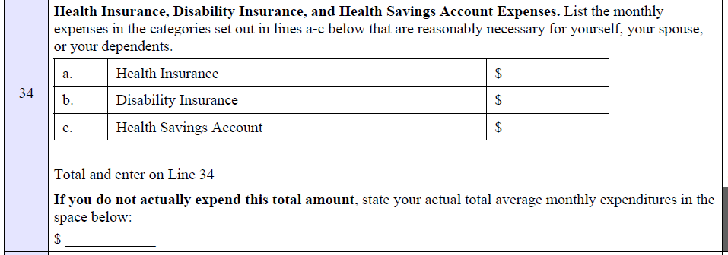
Health insurance

Slide 52
Line 34: Exception to “actually incur”
Health insurance,
disability insurance, and
health savings account
deductible if you ought to have them- even if you don’t now.

Slide 53

Expenses that require history
Contributions to care of household or family
Line 35
Charitable contributions
Line 40

Slide 54
Line 35: Care of others
  “Expenses you will continue to pay for care and
  support of member of household or family unable
  to pay such expenses”
  Might this include child at college?
  Note that members of “household” are included even if not “family”

Slide 55
Line 35: alternative if household size is limited to tax dependents
Consider deducting cost of housing aged relatives or others living in the house

Slide 56

Education expenses for minor
Costs of schooling for child under 18 actually incurred

Slide 57
Enhancements to IRS allowances
Excess home energy costs
Line 37
Additional food & clothing
Line 39

Slide 58
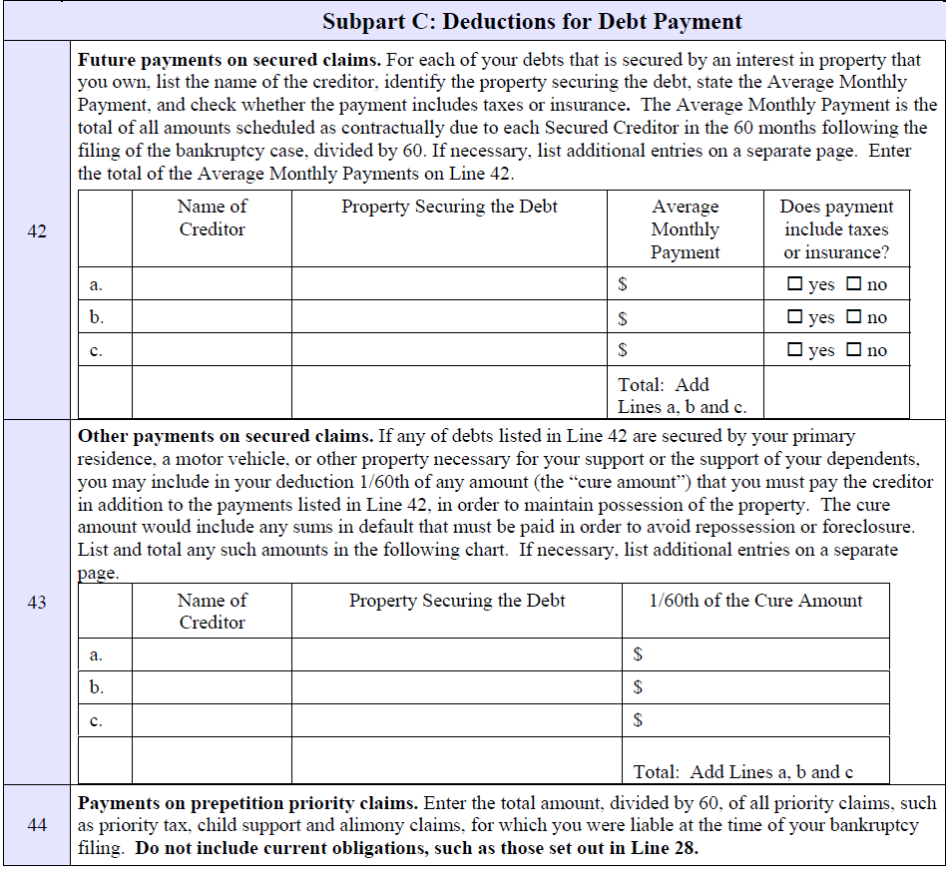
Deductions for debt payment

Slide 59
Calculate debt deduction
  Sum of payments contractually due to secured creditors in the 60 months following petition, divided by 60
  § 707(b)(2)(A)(iii)
Notes:
Not the payoff balance as that doesn’t have interest included

Slide 60

Real property future payments
Don’t forget
Real property taxes
HOA dues
Insurance
Judgment liens
Tax liens

Slide 61
Mortgage oddities
Consider changes in mortgage payments coming in next 60 months:
  End of interest-only payments
  Interest rate changes
  Negative amortization payments

Slide 62

Car loan on line 42
  Amount is contractual payment x number of remaining payments
  NOT
  Payoff balance - which excludes interest that accrues over period

Slide 63


Other payments on secured claims
Cure amount necessary to keep car or home necessary for support
Line 43

Slide 64
Priority claims
Notes:
Taxes and support due prepetition

Slide 65

Hypothetical Chap. 13 expense
  Deduction allowed for administrative expense in
  your district on that payment line 45
  Project Chapter 13 payment if eligible Huh?
  Plan to include at least car debt, priority claims, mortgage arrears and tax liens
Notes:
Total the expenses

Slide 66
Business expenses in 9th Circuit
Wiegand 386 BR 238
business expenses are an expense, not an adjustment to gross income
● in 7, put them on line 42, with note, or on line 56
● in 13, on line 57

Slide 67
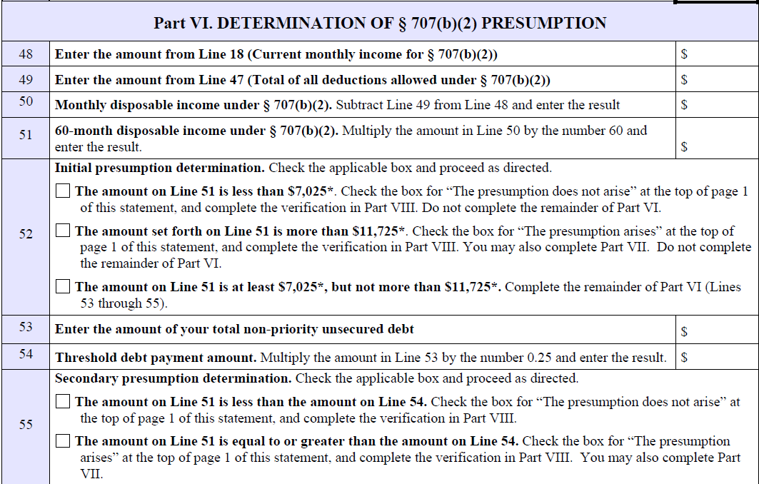
Determination of presumption

Slide 68

Do the math
  Calculate monthly disposable income by subtracting total deductions from CMI on line 18
  Multiply DMI by 60
  If product is greater than $11,725, presumption of abuse arises
  If product is more than $7,025, proceed to line 53

Slide 69
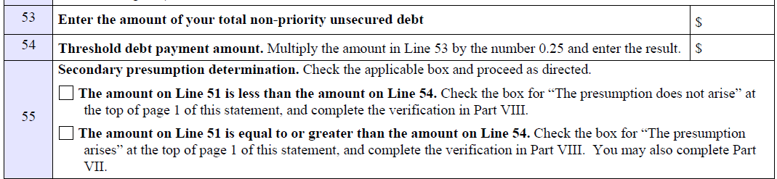
Secondary presumption

Slide 70
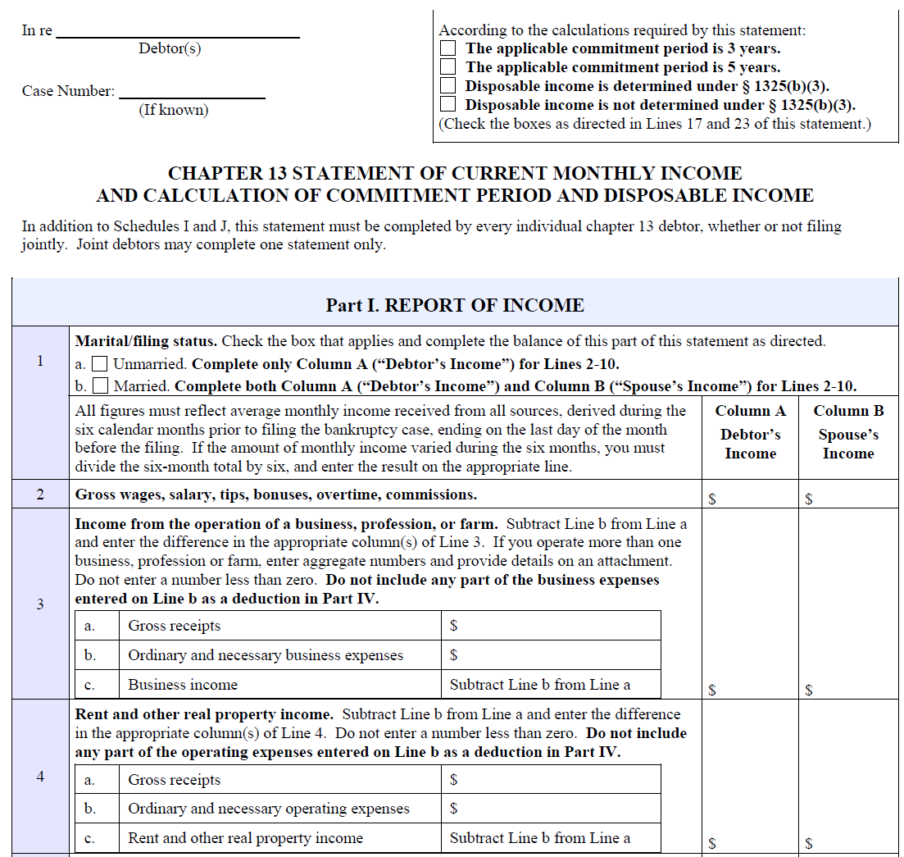
B-22 in Chapter 13

Slide 71


B-22C
Calculates
applicable commitment period
monthly disposable income

Slide 72
Where Chapter 13 is different
Additional deductions
  Support income
  401(k) contributions & loan repayment
  Special circumstances

Slide 73

Secured debt in 13
Projected secured debt doesn’t include payments on property to be surrendered or on liens to be stripped
Smith 401 BR 469 (9th Cir. BAP)

Slide 74

Troubleshooting

Slide 75
Where consistency required
Not
B-22 |  | Schedules I & J
Taxes- Line 25 | matches | Taxes withheld + income tax catchup
Involuntary deductions Line 26 | matches | Paycheck withholding for same
Court ordered payments Line 28 | matches | Alimony – support Line 14
Education for employ. Line 29 | matches | Entry on Schedule J
Childcare Line 30 | matches | Entry on Schedule J
Health care Line 19B + Line 31 | matches | Line 7
Contributions to others Line 35 | matches | Line 15

Slide 76

When presumption arises

Slide 77
Consider
Is any income attributable to other time period?
Revisit allowances for income taxes
Rethink sufficiency of health care budget
Analyze future changes in mortgage debt
Test whether single spouse filing works
Notes:
Make changes & corrections before filing

Slide 78
Download slides
www.bankruptcymastery.com/workshopslides

Slide 79
Mastering the Means Test
2012

